Slide 1
Society and Economy in Post-WWI America

Slide 2
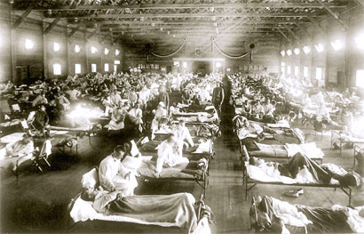
Spanish Flu Epidemic
The deadly Spanish Flu outbreak occurred just as The Great War began to wind down.
It infected one fifth of the world population (40 million) and killed more people than WWI.
The port areas, major cities, and transportation centers saw the earliest cases of influenza.

Slide 3
From a Letter from a Physician to a Colleague During the Flu Epidemic
“These men start with what appears to be an ordinary attack of LaGrippe or Influenza, and …rapidly develop the most viscous type of Pneumonia that has ever been seen. Two hours after… they have the Mahogany spots over the cheek bones, and a few hours later you can begin to see the Cyanosis extending from their ears and spreading all over the face, until it is hard to distinguish the coloured men from the white. It is only a matter of a few hours then until death comes, and it is simply a struggle for air until they suffocate. It is horrible. One can stand it to see one, two or twenty men die, but to see these poor devils dropping like flies sort of gets on your nerves.”

Slide 4
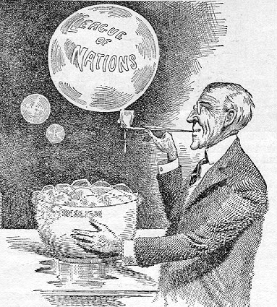
Rejection of Versailles
President Wilson and Senator Henry Cabot Lodge remained bitter enemies throughout their careers.
Wilson was a Democrat and an idealist, Lodge was a Republican and a realist.
The President's party lost Congress in the 1918 elections.
Lodge became both Senate Majority Leader and chairman of the Senate Foreign Relations Committee.
Lodge’s support for the Treaty and its provision for a League of Nations was crucial for it to pass.

Slide 5
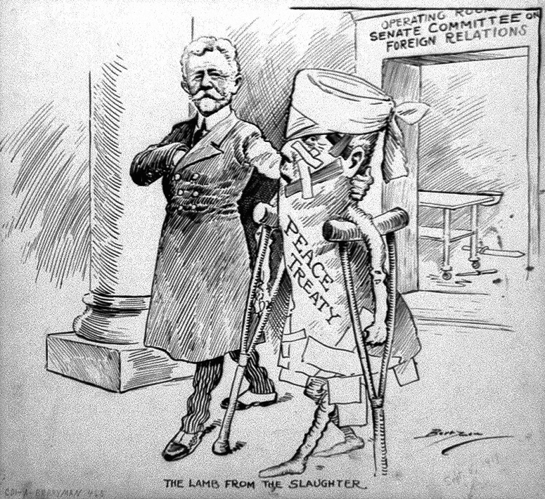
Rejection of Versailles
Wilson bypassed the Senate during Treaty negotiations and sometimes publicly insulted them.
Lodge advocated a more punitive settlement against Germany, rather than Wilson's conception of a "peace without victory."
The Senate added a number of amendments and "reservations" to the treaty.

Slide 6
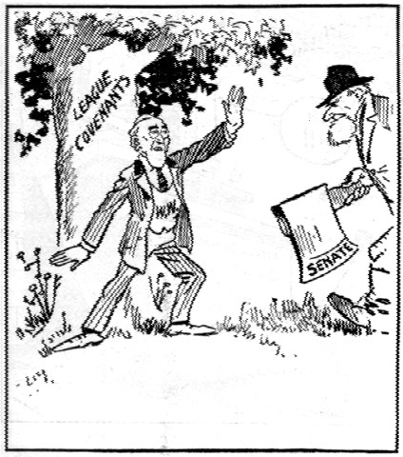
Rejection of Versailles
Wilson was unwilling to compromise and began touring the country to promote the Treaty to the American people.
In October 1919, the President suffered a stroke while on the road.
On November 19, 1919, the Senate rejected a peace treaty for the first time.
Congress later passed a joint resolution ending the war with Germany.
Cartoon entitled, “Touch Not a Single Bough.”

Slide 7
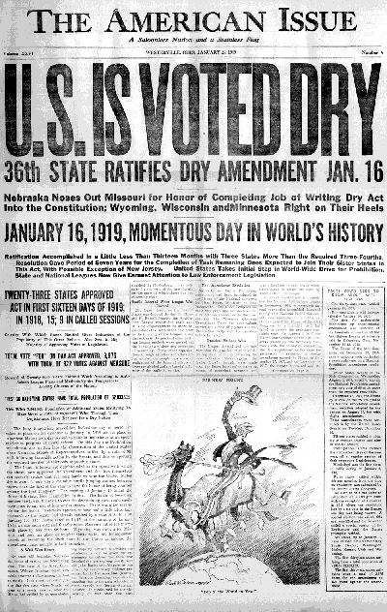
The Volstead Act Passes Over Wilson's Veto
WWI bolstered the Temperance Movement because many associated sobriety with patriotism due to:
  the German ownership of breweries
  the necessity to conserve grain during wartime.
The 18th Amendment was ratified in 1919 and took effect in 1920.
The Volstead Act clarified the new rules.
Though Wilson advocated temperance, he vetoed the Volstead Act on constitutional and ethical grounds. His veto was overridden by Congress.

Slide 8
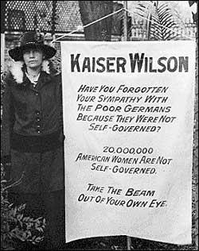
The 19th Amendment
Although briefly postponed due to the outbreak of WWI, the ratification of the 19th Amendment in 1919 finally allowed women to represent themselves at the polls.
The culmination of Progressivism's agenda came with success of the temperance and women's suffrage movements; thus, the years immediately after WWI were a prelude to the conservatism of the 1920's.

Slide 9
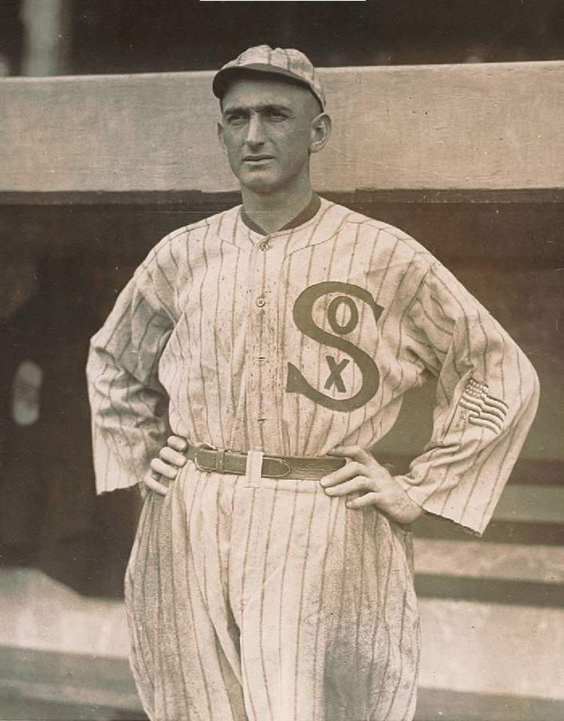
The 1919 Black Sox Scandal
In the 1919 World Series, the Chicago White Sox lost to the vastly inferior Cincinnati Reds.
In 1921, eight players were indicted for throwing the World Series, but they were acquitted in a corrupt trial.
White Sox owner Charles Comiskey paid his players very little compared to other teams.
A New York gambler took advantage of this discontent, offering players thousands of dollars to throw the Series.
The tragedy of the Series was illiterate superstar outfielder “Shoeless” Joe Jackson who did not understand the arrangement and was banned for life.
“Shoeless” Joe Jackson

Slide 10
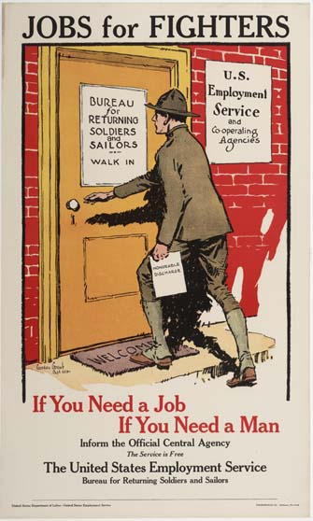
A Difficult Economic Transition
The American economy had a few very difficult years between 1918 and 1921 during transition back to a peacetime economy.
Wartime production ceased, inflation rose, and unemployment spiked as the troops returned home to find jobs.
Nativist sentiments were inflamed because some Americans viewed immigrants as economic competitors.
The recession was short-lived, since WWI stimulated development and investment in new technology that contributed to the business boom of the 1920's.

Slide 11
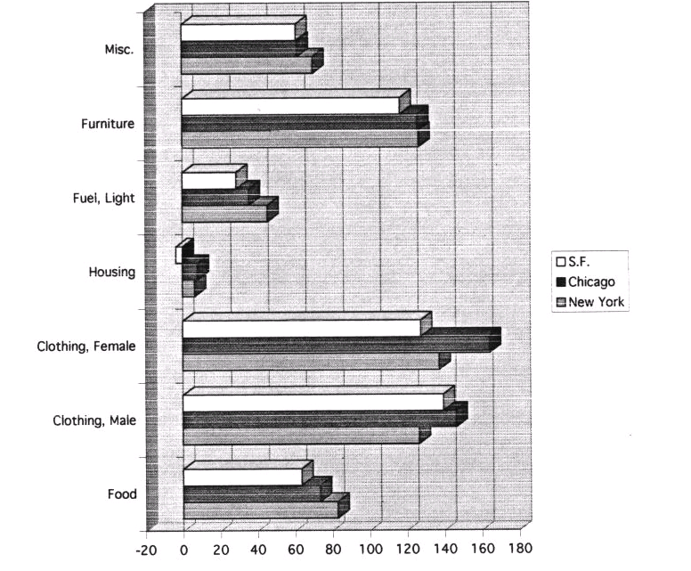
Percent Increase in Cost of Living, 1914-1919

Slide 12
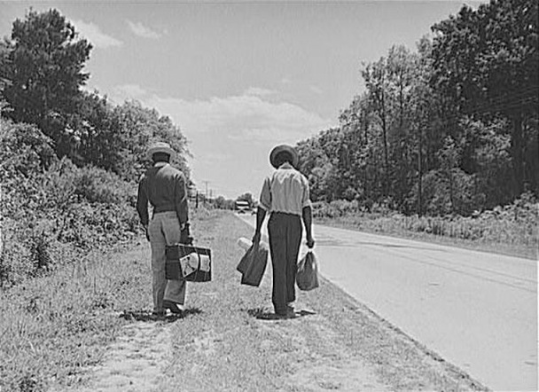
The Great Migration
African-Americans left the South for the industrial cities of the North in large numbers in the century following the Civil War.
The Great Migration drew roughly a million African-Americans from the rural South to the cities in the North between 1915 and 1920.
African Americans were drawn to the better pay, a higher standard of living, and improved political rights in the cities of the North.

Slide 13
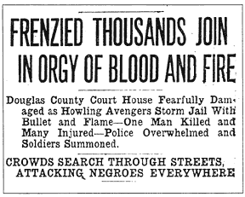
1919 Race Riots
The summer of 1919 became known as "red summer" because over two dozen cities including Washington DC, Chicago, and Omaha, experienced violent, racially-motivated uprisings.
In the South, lynchings occurred frequently and in the North, whites sometimes reacted violently to African Americans arriving as the Great Migration was underway.
Headline from the Omaha World-Herald, September 29, 1919

Slide 14
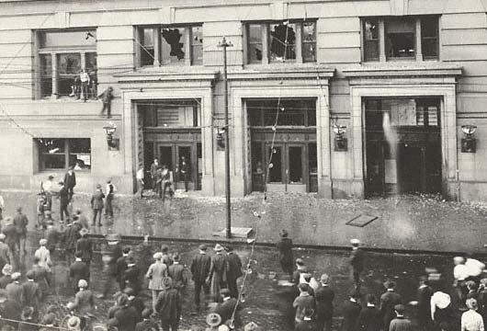
1919 Race Riots
The Omaha Race Riot occurred September 28, 1919. This photo shows rioters on the south side of Douglas County Courthouse in Omaha, Nebraska.

Slide 15
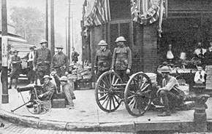
1919 Race Riots
Soldiers on guard at 24th and Lake streets in Omaha, following the riot.

Slide 16
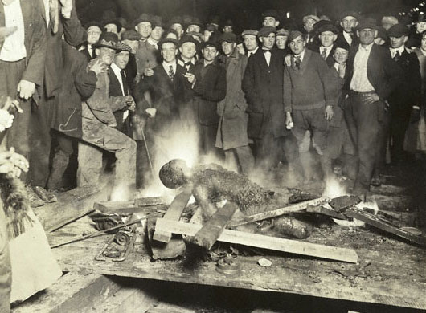
1919 Race Riots
A disturbing photo of the burning of Will Brown's body during the Omaha riot.

Slide 17
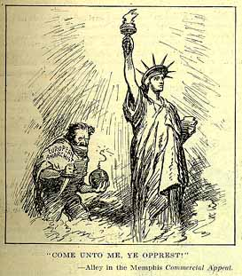
The Red Scare
A growing climate of xenophobia, anti-radicalism, and nativism accompanied a repressive shift in the government's attitude toward dissent during WWI and into the 1920’s.
Many feared anarchism or Bolshevism would seize the United States.
During this period, "alien" residents were targeted and deported.
The First Amendment rights of Americans were sometimes supplanted as the country succumbed to anti-communist hysteria.
A “European Anarchist” stalks Lady Liberty.

Slide 18
From A. Mitchell Palmer’s “The Case Against the Reds”
“Like a prairie-fire, the blaze of revolution was sweeping over every American institution … eating its way into the homes of the American workmen, its sharp tongues of revolutionary heat were licking the altars of the churches, leaping into the belfry of the school bell, crawling into the sacred corners of American homes, seeking to replace marriage vows with libertine laws, burning up the foundations of society. …”
"there could be no nice distinctions drawn between the theoretical ideals of the radicals and their actual violations of our national laws.“

Slide 19
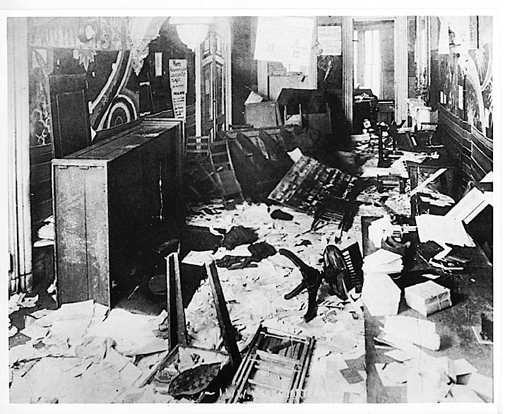
The Palmer Raids, 1918-1921
In 1919, a period of labor disturbances and several bombing incidents linked to anarchists resulted in aggressive targeting of suspected radicals by the government.
Attorney General A. Mitchell Palmer launched a series of raids against radical and progressive organizations, often without search warrants.
By early 1920, more than five thousand people were arrested. Many of the suspects were deported, sometimes illegally

Slide 20
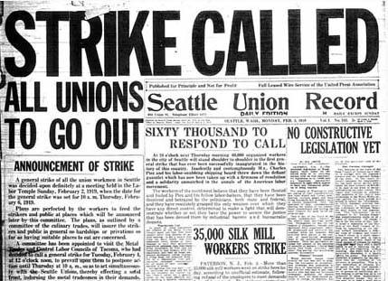
The Seattle General Strike
The Seattle General Strike occurred in February 1919, with over 100 unions participating.
Americans denounced the strike, characterizing it as a threat to the social order and a possible prelude to a Bolshevik-style revolution.
Seattle's mayor Ole Hanson summoned the police to arrest socialists and the staff of labor-owned press outlets.
The national press dubbed Hanson "The Savior of Seattle."
The strike lasted only a few days, but the anti-radical sentiment endured well into the 1920's as Americans yearned for a return to calm, simplicity, "Americanism."

Slide 21
From Ole Hanson’s Statement on the Seattle General Strike
"... We swore in 1,000 extra police and hold in reserve citizens armed with rifles and shotguns. I gave orders to shoot on sight any disturbance of the peace. They knew from experience, they had at a riot a few weeks ago, that we meant business and believe me, we did. I wanted a showdown. If there is a majority of these (unprintable) in the United States I don't want to live here. … we would fight until we were dead before we even allowed them to turn out one eight-candlepower light..."

Slide 22
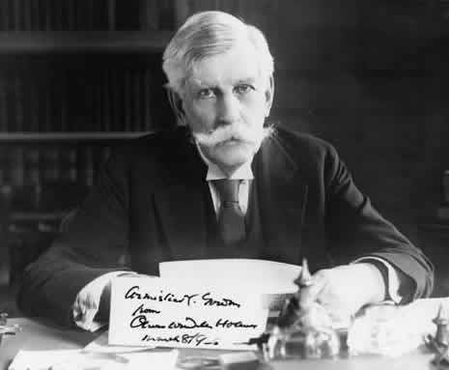
Schenck v. United States, 1919
Concerns about radical elements in the country sometimes led the curtailment of rights by the government.
The nation was traumatized by the war, and thus more willing to exchange some of its freedom for security.
In Schenck v. United States, the Court concluded that:
  speech normally protected by the First Amendment may not be acceptable during a time of war.
  courts are not obligated to protect words that “create a clear and present danger" to the government and the nation.
Chief Justice Oliver Wendell Holmes

Slide 23
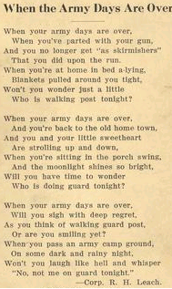

Slide 24
Society and Economy in Post-WWI America Powerpoint Photo Citations
Slide 2: http://mednews.stanford.edu/story_images/flu-history-110905.jpg
Slide 3: http://web.uct.ac.za/depts/mmi/jmoodie/influen2.html
Slide 4: http://history.acusd.edu/gen/WW2Pics/81486.GIF
Slide 5: http://www.senate.gov/artandhistory/history/resources/graphic/large/Versailles.jpg
Slide 6: http://history.acusd.edu/gen/WW2Pics/81481.GIF
Slide 7: http://xroads.virginia.edu/~MA03/holmgren/prohib/images/news_dry.gif
Slide 8: http://www.archives.gov/national-archives-experience/images/kaiser_wilson_poster.jpg
Slide 9: http://www.blackbetsy.com/imagefarm/joe-jackson-1917-700.jpg
Slide 10: http://docsouth.unc.edu/wwi/41909/A-441-50.jpg
Slide 11: http://ecuip.lib.uchicago.edu/diglib/social/chi1919/aline/a3/a3colcit.gif
Slide 12: http://www.inmotionaame.org/
Slide 13, 15, 16: http://bss.sfsu.edu/tygiel/Hist427/1919Photos/omaharaceriot.htm
Slide 14: http://bss.sfsu.edu/tygiel/Hist427/1919Photos/nebrioters.jpg
Slide 17: http://www.law.umkc.edu/faculty/projects/ftrials/SaccoV/redscare.html
Slide 18: http://chnm.gmu.edu/courses/hist409/palmer.html
Slide 19: http://sunsite.berkeley.edu/Goldman/Exhibition/eg25.jpg
Slide 20: http://faculty.washington.edu/gregoryj/strike/
Slide 21: http://www.lib.washington.edu/exhibits/STRIKES!/exh.html
Slide 22: http://www.healthsystem.virginia.edu/internet/library/images/historical/eugenics/Holmes.jpg
Slide 23: http://chaucer.library.emory.edu/wwi/images/realsize/army_days.jpg

